Slide 1
WELCOME TO SWEDEN –
53rd Conference of Directors of EU Paying Agencies
Mrs. Christina Nordin
Director General
Swedish Board of Agriculture

Slide 2



Climate changes
Antibiotic
resistance
Loss of biodiversity
A growing
population

Slide 3
We must use the CAP Strategic Plans to meet the future. We have to think ahead…
Environmental sustainability
We have to use all our tools to face the challenges
The CAP Strategic Plans are important tools
We need to think holistically
– all perspectives of sustainability
Social sustainability
Economic sustainability
Social sustain

Slide 4

The Swedish CAP Strategic Plan
A simpler and more focused policy
Focus on the national food strategy
Productivity, profitability and competitiveness of the sector
Animal welfare
Increased ambition in the environmental and climate fields
Measures to strengthen agricultural knowledge and innovation systems
Simplification
Long-term attractiveness and faith in the support systems
Implementation on time!
Foto: Helena Wahlman/imagebank.sweden.se

Slide 5
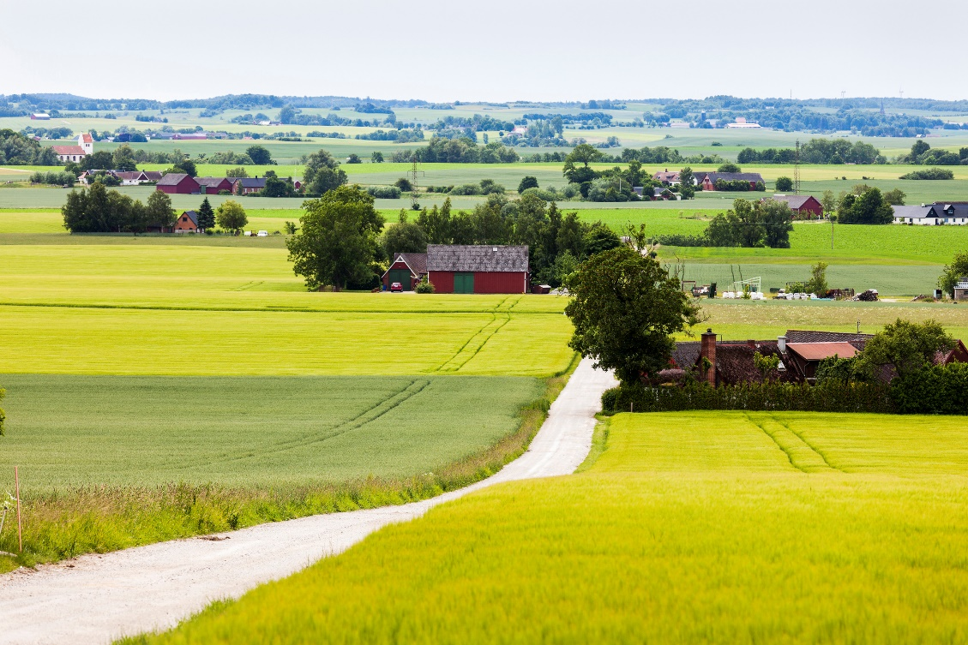
Key issues
How can we get lower error rates and administrative costs while increasing the ambition and effect?
The need of increased production versus the risk of reduced production due to higher environmental and climate ambitions.
Importance of using the area monitoring system wisely.

Slide 6


