Slide 1


Main findings in the fight against fraud in Agriculture – looking at Member States’ experience
Katharina HERRMANN
OLAF, Unit C1
8 June 2023

Slide 2
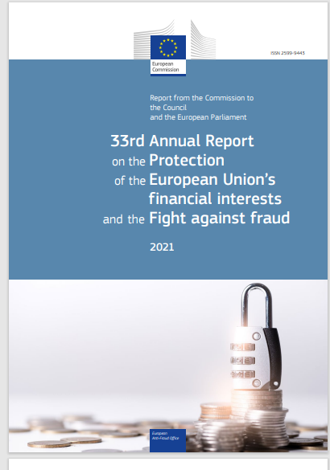
Annual Reports on the Protection of the EU’s financial interests
33th annual report on the protection of the European Union’s financial interests and the fight against fraud – 2021
(PIF report)
https://anti-fraud.ec.europa.eu/system/files/2022-09/pif-report-2021_en_0.pdf
Notes:
As just said, one outstanding activity of OLAF is the drafting on the annual report on …. Which is commonly referred to as PIF report > it is available in Spanish, the link indicated here brings you to the Spanish text.
Please be aware that it is not an OLAF report; OLAF prepares the report on behalf of the Commission.
This is what the report looks like, the latest edition was the one published in September 2022 and covered the year 2021. We are now preparing the report covering the year 2022, should be published in July this year.
In short, the PIF Report details the measures taken at EU and national level to combat fraud affecting the EU budget.
As I will show in more details later, the Commission’s PIF report provides among other an overview of the CAP fraud, presented in terms of number of cases of fraudulent irregularities reported by MS and amounts involved, and includes statistics and related background analyses.
The analysis of this information makes it possible to identify the areas most exposed to irreg and fraud, and aims at a better targeting of action at both EU and national level.

Slide 3
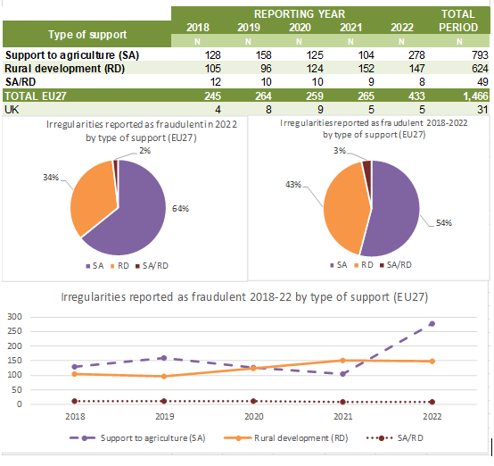
1. (Preliminary) key results from the up-coming « PIF report - 2022 »
Number of irregularities reported as fraudulent by type of support – 2018-2022, CAP, EU 27
and amounts involved
CAP, 2018-2022, EU 27:
1,466 fraudulent irregularities reported
corresponding to an amount of EUR 167,133,306

Slide 4
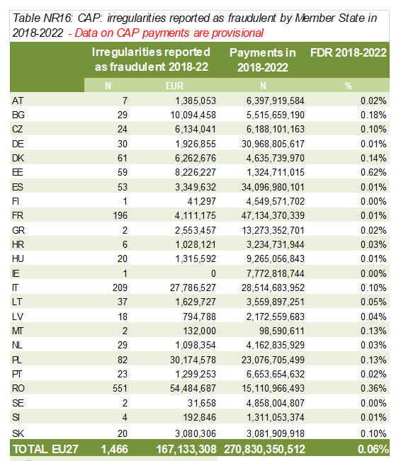
1. (Preliminary) key results from the up-coming « PIF report - 2022 »
Detection of CAP irregularities reported as fraudulent by Member States
FDR – Fraud Detection Rate:
ratio of financial amounts related to fraudulent irregularities on the total payments made

Slide 5
2. Specific analysis: modus operandi
Overview of the most frequent categories (or combinations of categories)
of irregularities reported as fraudulent
Direct payments to farmers | Market measures | Rural development
1. Request for aid, also in combination with violations concerning the beneficiary | 1. Falsification of documentary proof or requests | 1. Falsification of documentary proof or requests
2. Falsification (of documentary proof) | 2. Action not implemented | 2. Action not implemented
3. Product, species and/or land | 3. Product, species and/or land | 3. Requirements not respected by beneficiary

Slide 6
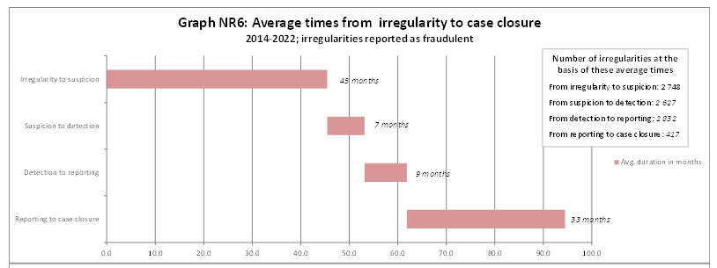
3. Anti-fraud work carried out and results obtained by the Member States
Duration of irregularities

Slide 7
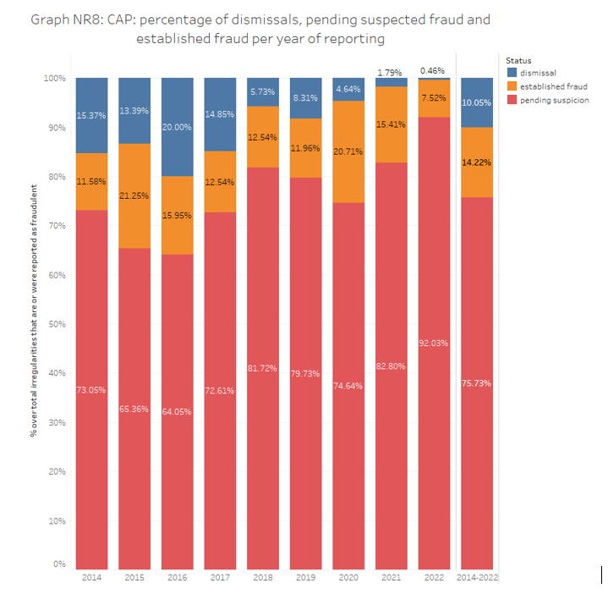
3. Anti-fraud work carried out and results obtained by the Member States
Member States’ follow-up to suspected fraud (2014-2022)

Slide 8
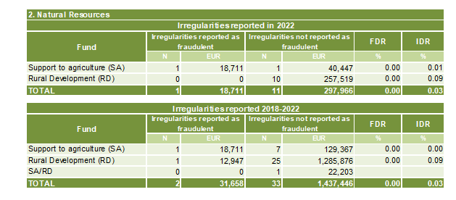
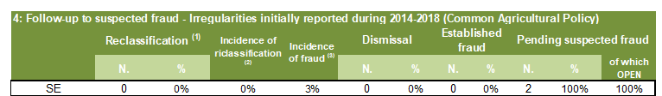
4. Country fact sheets
As in past years: main quantitative indicators concerning the detection and reporting of fraudulent and non-fraudulent irregularities
!

Slide 9
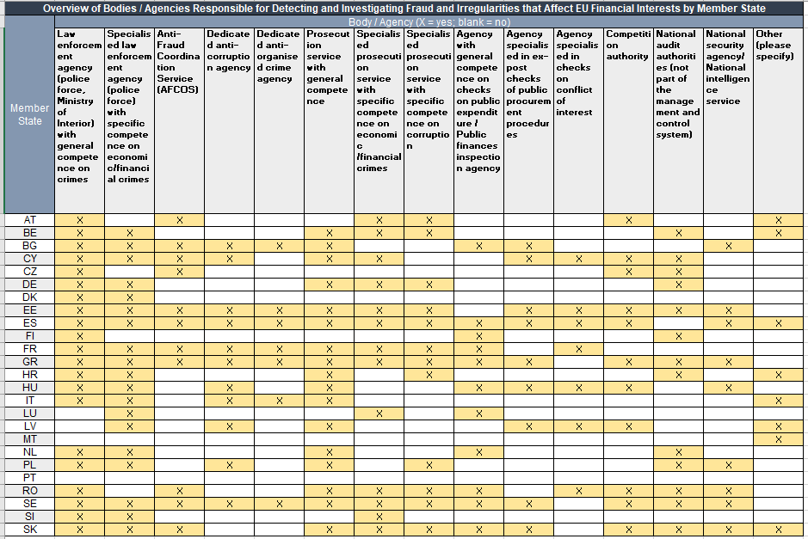
4. Country fact sheets
New: National anti-fraud landscape
“Bodies external to the MCS competent for detection and investigation of fraud and irregularities affecting the EU’s financial interests”

Slide 10
5. Conclusions
Understanding fraud to fight it more efficiently
Improving the quality of available data: reporting of suspected fraud
Innovating the fight against fraud: the case for digitalization
Strengthening the anti-fraud governance

Slide 11
THANK YOU!

