Slide 1
Area Monitoring System
53rd Conference of Directors of EU Paying Agencies
8 June 2023, Stockholm, Sweden
IACS team, Unit C1 - CAP Strategic Plans Coordination - DG AGRI

Slide 2
Summary
The Area Monitoring System
AMS Implementation Status in Member States
AMS quality assessment (QA)

Slide 3
The Area Monitoring System (AMS)

Slide 4
What is the AMS?
Definition : “a procedure of regular and systematic observation, tracking and assessment of agricultural activities and practices on agricultural areas by Copernicus Sentinels satellite data or other data with at least equivalent value” (R. 2021/2116 Art. 65(4)(b))
Main characteristics :
  Exhaustive coverage
  Automated processing
  Mandatory

Slide 5
Exhaustive coverage
What should be monitored?
  All monitorable eligibility conditions (defined by MS in CSP) of all area-based intervention (minimum BISS and ANC in 2023 if MS has technical limitations)
What does monitorable mean?
  Initially : Can be monitored by Copernicus Sentinels satellites data or data with at least equivalent value
  Later on : Can be monitored by geotagged photos
What about non-monitorable eligibility conditions?
  Not part of AMS, but of AMS QA and control system

Slide 6
Exhaustive coverage
Monitored by Sentinel :
  To cover full population : Possible to combine Copernicus Sentinel satellites data with data of at least equivalent value
  To reduce non conclusive (“yellow”) cases : Possible to perform a cascaded analysis of Sentinel satellite data and/or other types of data with at least equivalent value
Monitored by geotagged photos :
  If no geotagged photo is provided by the applicant upon request, then it should be considered a non-compliance (“red” case)

Slide 7
Exhaustive coverage
Prior to analysis of compliance with eligibility conditions, the AMS should detect:
  presence of ineligible area, in particular due to permanent structures
  presence of ineligible land use
  change in the category of agricultural area whether it is arable land, permanent crop or permanent grassland

Slide 8
Automated processing
The AMS should be an automated process
Checks by Monitoring
Area Monitoring System
Eligibility condition
Eligibility condition
Yellow
Green
Red
Green
Yellow
Red
Manual or semi-automated follow-up of yellow cases possible
No follow-up of yellow cases required

Slide 9
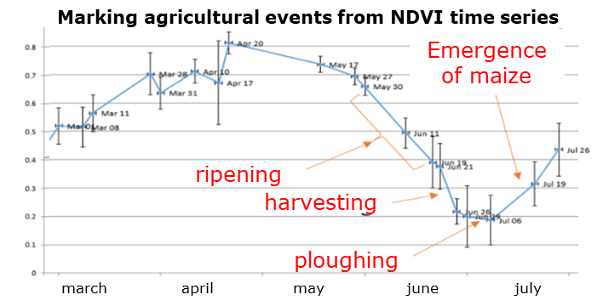

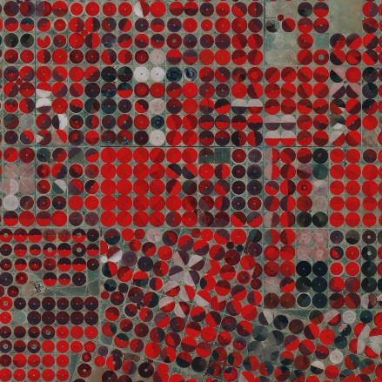
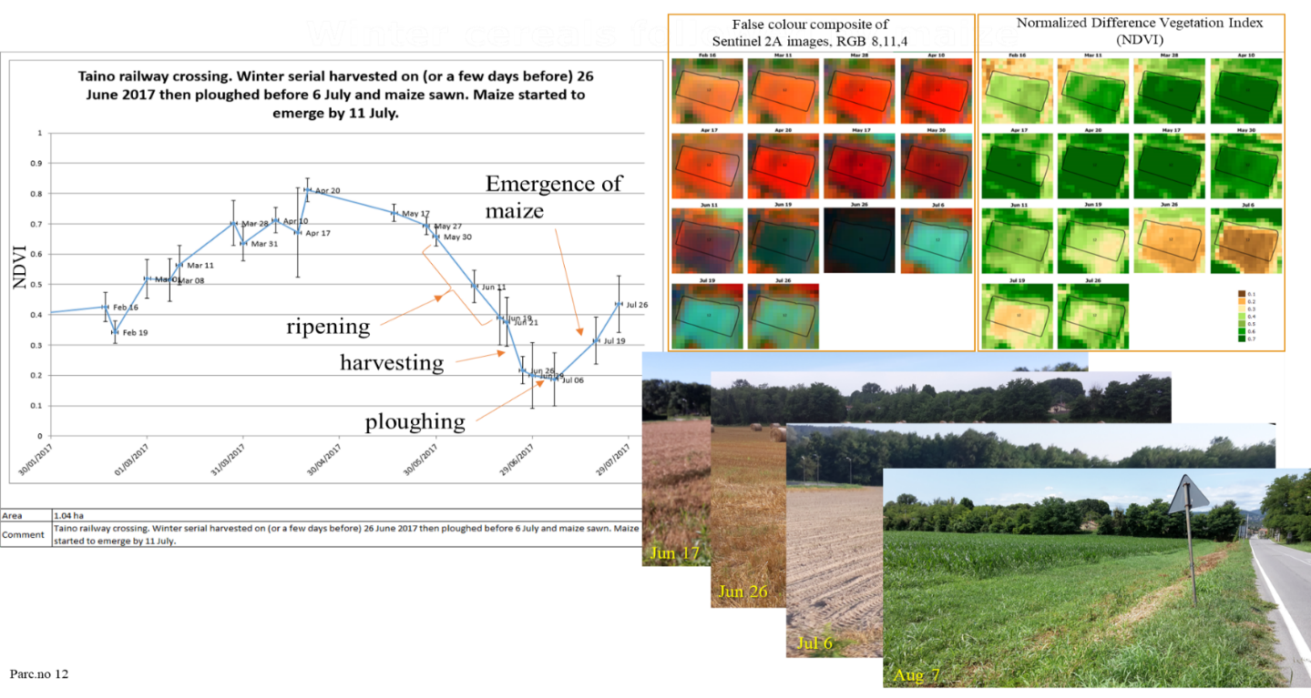
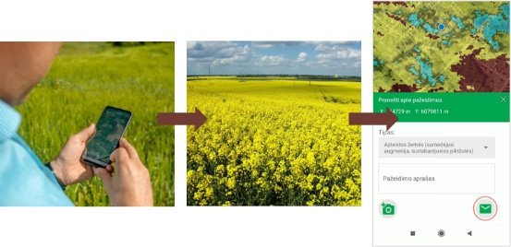

Process
Ineligible area/land use or change in category
Eligibility condition OK
Copernicus Sentinel data + equivalent value
NDVI time series of parcel with winter cereal
march
april
may
june
july
No conclusive result
Automatic analysis
Eligibility condition
NOT OK
Geotagged photos
Alert to farmer to amend application!

Slide 10
Mandatory
“Member States shall set up and operate an area monitoring system, which shall be operational from 1 January 2023” (R. 2021/2116 Art. 70(1))
Timeline of implementation
2023
All monitorable area-based interventions (minimum BISS and ANC in 2023 if MS has technical limitations)
2024
All monitorable area-based interventions
Copernicus Sentinel satellites data + equivalent
2025
All monitorable area-based interventions
Copernicus Sentinel satellites data + equivalent + geotagged photos
2027
Copernicus Sentinel satellites data + equivalent
All monitorable area-based interventions (at least 70% interventions with geotagged photos)
Copernicus Sentinel satellites data + equivalent + geotagged photos

Slide 11
AMS Implementation Status in Member States

Slide 12
Survey
A survey on the implementation status of the AMS was sent to Member States (MS) end of April
Intention :
  to better understand your diverse situations
  to better support you in the implementation of the AMS
This section provides a short overview of main trends
Status : 31 May 2023

Slide 13
Response rate

Slide 14
1a – 1e: Interventions subject to AMS
Many interventions subject to AMS, and fully monitored in some MS

Slide 15
1a: Interventions subject to AMS in 2023

Slide 16
2: Geotagged photos
Around 40% of MS use already geotagged photos (automatic processing inside of AMS)

Slide 17
3: Use of external services providers
At least 60% of MS use external services providers

Slide 18
4: Use of external solutions
Relatively low uptake of outputs from EU-funded projects (Niva, Sen4CAP)

Slide 19
5: Geotagged photos as counter evidence
Relatively many MS accept geotagged photos serving as counter evidence after « yellow » or « red » AMS results

Slide 20
6: AMS hurdles identified by MS
Mostly no issue in accessing cloud services
Challenges with recruiting skilled IT staff
Some issues with algorithm availability

Slide 21
First Impressions
Summary based on 23 replies
In general, work progresses well with some challenges

Slide 22
AMS quality assessment (QA)

Slide 23
AMS QA - Purposes
Assess the reliability of the implementation of AMS
Provide diagnostic information on the sources of incorrect decisions at the level of interventions and eligibility conditions (e.g., help improve the system)
Ensure that the integrated system provides reliable, comprehensive and verifiable data in the annual performance reporting

Slide 24
AMS QA - What should be checked?
Sample of parcels covering :
  all area-based interventions
  all eligibility conditions (monitorable & non-monitorable)
Sample should be the same as the GSA QA

Slide 25
AMS QA - Consequences
If the QA reveal deficiencies, MS shall adopt remedial actions​
If the remedial actions implemented by the MS do not improve the situation in the subsequent year, the MS should submit an action plan​ to the Commission

Slide 26
Can the AMS QA contribute to controls?
R. 2022/1172
Art 5(6)
For simplification purposes, MS may decide to take the AMS QA and GSA QA into account in respect to the obligation to set up a control system
  However, the remaining specific control provisions* should still be ensured by the MS, such as, for example, the risk component of the sample (the samples of the QAs are not risk based samples)
For an intervention under AMS for which all ElCo are monitorable and monitored, MS may decide that the obligation to set up a control system is fulfilled for that intervention
* at least provisions established in Articles 59, 60 (even if not referred to in Art. 5(6) they do apply to all interventions) and 72 of R. 2021/2116

Slide 27
Thank you
Contact : AGRI-IMPLEMENTATION-SUPPORT@ec.europa.eu

