Slide 1
Risk-based model for control of circumvention in Denmark
Conference of Directors
Henrik Berg

Slide 2
Introduction
Circumvention is the action of overcoming a problem or difficulty, typically in a clever and hidden way.
National Audit-case released in 2021 proved the existence of circumvention in Denmark
Our Minister for Food, Agriculture and Fisheries decided to introduce 100% control
- including a full recovery for previous years
→ Automatic check for complex owner-ships
→ Calculation of possible benefits from circumvention
→ Development of risk-based models
Establishment of a new office with the task to handle fraud and circumvention-cases

Slide 3
Type example of circumvention – two applications but only one farmer
2 mio Euro.
1 mio. Euro.
1 mio. Euro.
Real owner
CVR 1
CVR 2
Aid-
application
Aid-
application
Paying agency
Cieling – 1 mio. Euro
Cieling – 1 mio. Euro

Slide 4
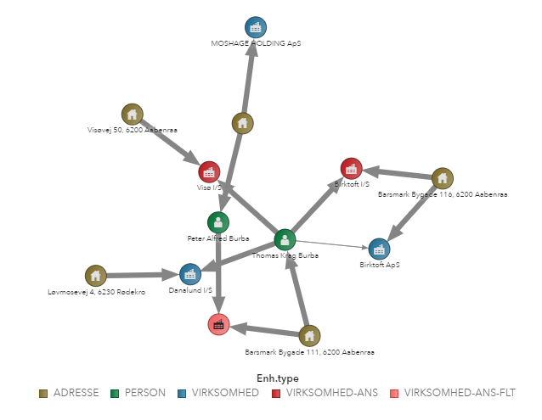
Visualization of complex ownership relationships
Source of information:
- Central Business Register
- Information from IACS and
non-IACS system
Network generated by:
- Coincidence of ownership
- Address match
Weekly update

Slide 5
Main incentives for circumvention
Measures and aid schemes with ceilings – amount or hectares
- Young farmers Scheme
- Basic payment scheme - CAPPING
- Less favoured areas (LFA)
- M4 investments (RDP, non-IACS)
Avoidance of sanctions
- Cross-compliance
- Long-term commitments, transfer of ownerships
- Greening, minimum thresholds

Slide 6
The Risk-based model for Area payment Schemes
All single payment schemes
Complex ownership (30%)
Only one owner (70%)
Economic incentives to circumvention?
Yes
No
Risk-based selection for control, (0,3%)
Random selection, QA (0,1%)
Ministeriet for Fødevarer, Landbrug og Fiskeri - Landbrugsstyrelsen
Notes:
155 sager fra risikobaseret udtagning, 117 fra højrisiko og 38 fra lavrisiko. Yderligere 1372 i ordinær udtagning og 25 i kvalitetssikring.
Komplekse ejerforhold kort sagt: Ændringer i ejerforhold en årrække tilbage eller mindst 2 FS-ansøgninger

Slide 7
Non-IACS investment payments – red flags
Payment schemes
Measure with economic incentives?
Complex ownership? (10%)
Yes
Control for circumvention

Slide 8
Results of the controls up to now – circumvention
Results from more than 2000 controls
Non-IACS investment schemes: only a few cases
Area based schemes: less than 50 cases
- more than 90% of the cases included young farmers schemes
- some cases with recoveries up to 5 years

Slide 9
Expectations for 2023 and onwards
- Explore the value of risk-models/ algorithms build for tax administration
- Further development of the risk-based model in partnership with other MS
- Explore possible international cross-border risks by use of e.g. Arachne

Slide 10
THANK YOU!
Contact info: hber@lbst.dk

