Slide 1


Invitation to the 54th
Conference of Directors
of EU Paying Agencies
VALENCIA 6-8 NOVEMBER 2023
María José Hernández, General Director FEGA

Slide 2

      Organizational matters
Organized by FEGA coordination body.
Coordination body of PA in Spain
Within the competence of the Ministry of Agriculture, Fisheries and Food
Located in Madrid

Slide 3
      54th Conference of directors of EU paying agencies.
      Conference Hall of the Ciudad de las Artes y las Ciencias
      (Av. del Professor López Piñero, 7, 46013. Valencia).
      Guided City Tour and informal dinner – 6 November
      Guided architectural tour and official dinner at the Restaurant Submarine Oceanografic Valencia - 7 November.

Slide 4




      CIUDAD DE LAS ARTES Y DE LAS CIENCIAS

Slide 5



      INFORMAL VISIT AND DINNER

Slide 6
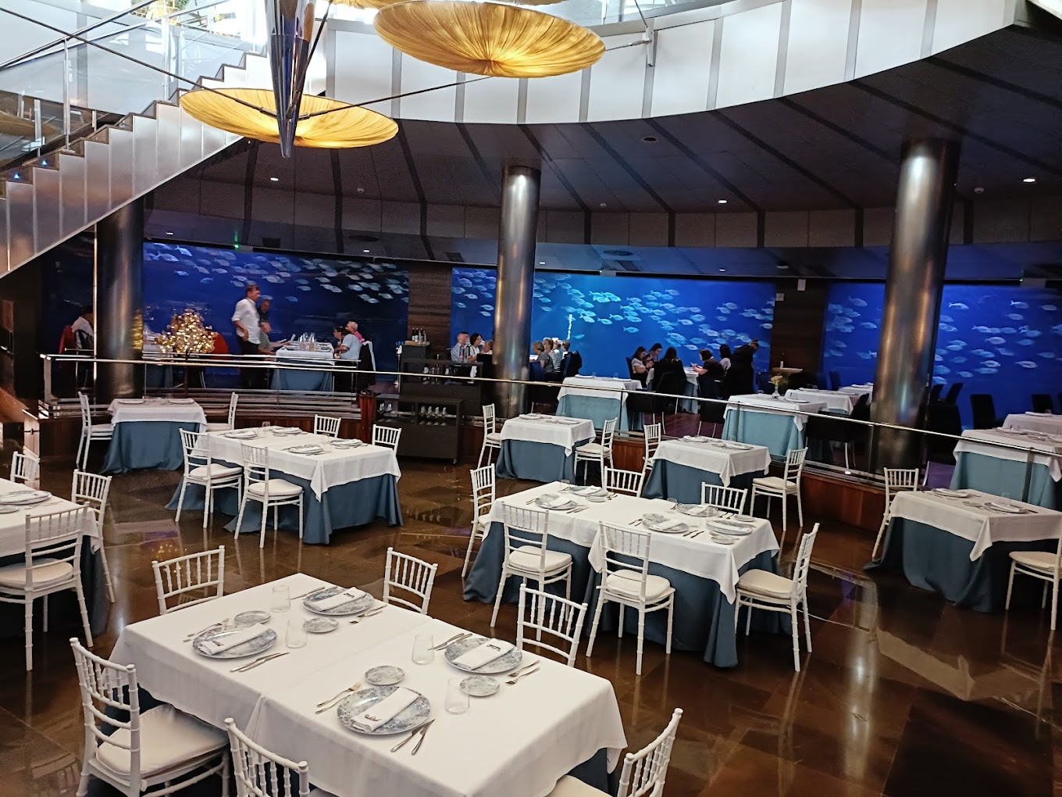
OFFICIAL DINNER

Slide 7
PRELIMINARY TOPICS
Follow up from previous Conferences
State of play of the implementation of CAP 2023-2027
  Applications 2023
PAs, DG AGRI, ECA, OLAF, other bodies
State of play of the works of Learning Network
Workshops (IACS Quality assessment ; AMS and geotagged photos; APR 2023)
Next conference (BE Presidency)

Slide 8
TIMELINE
Preliminary program: July
Official invitation: September
Online registration: October
Final agenda: October
54th Conference: 6 – 8 November

Slide 9
THANK YOU
FOR YOUR
ATTENTION
presiden@fega.es

